Slide 1
Database Design Chat 005
What does good enough mean to you?

Slide 2
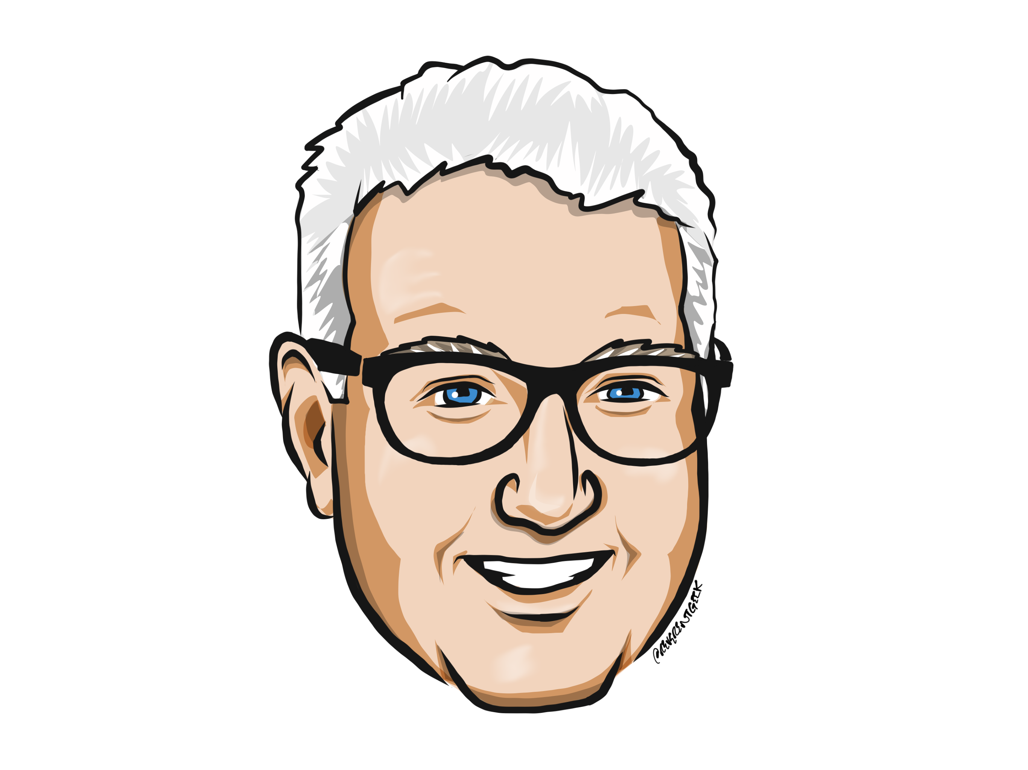
Louis Davidson (drsql)
https://linktr.ee/drsql

Slide 3
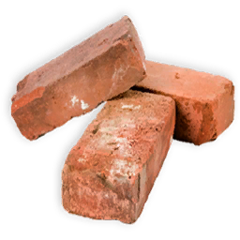
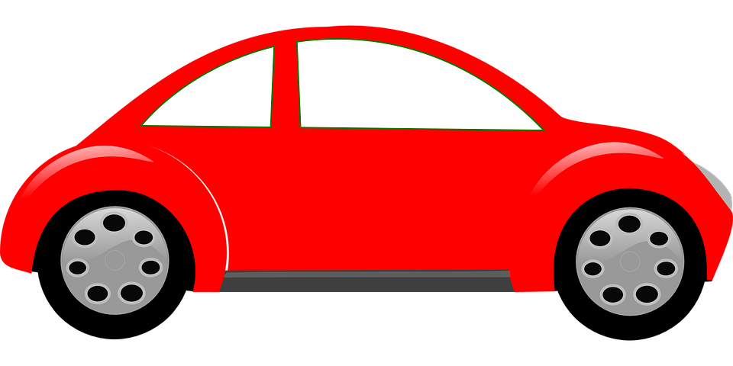
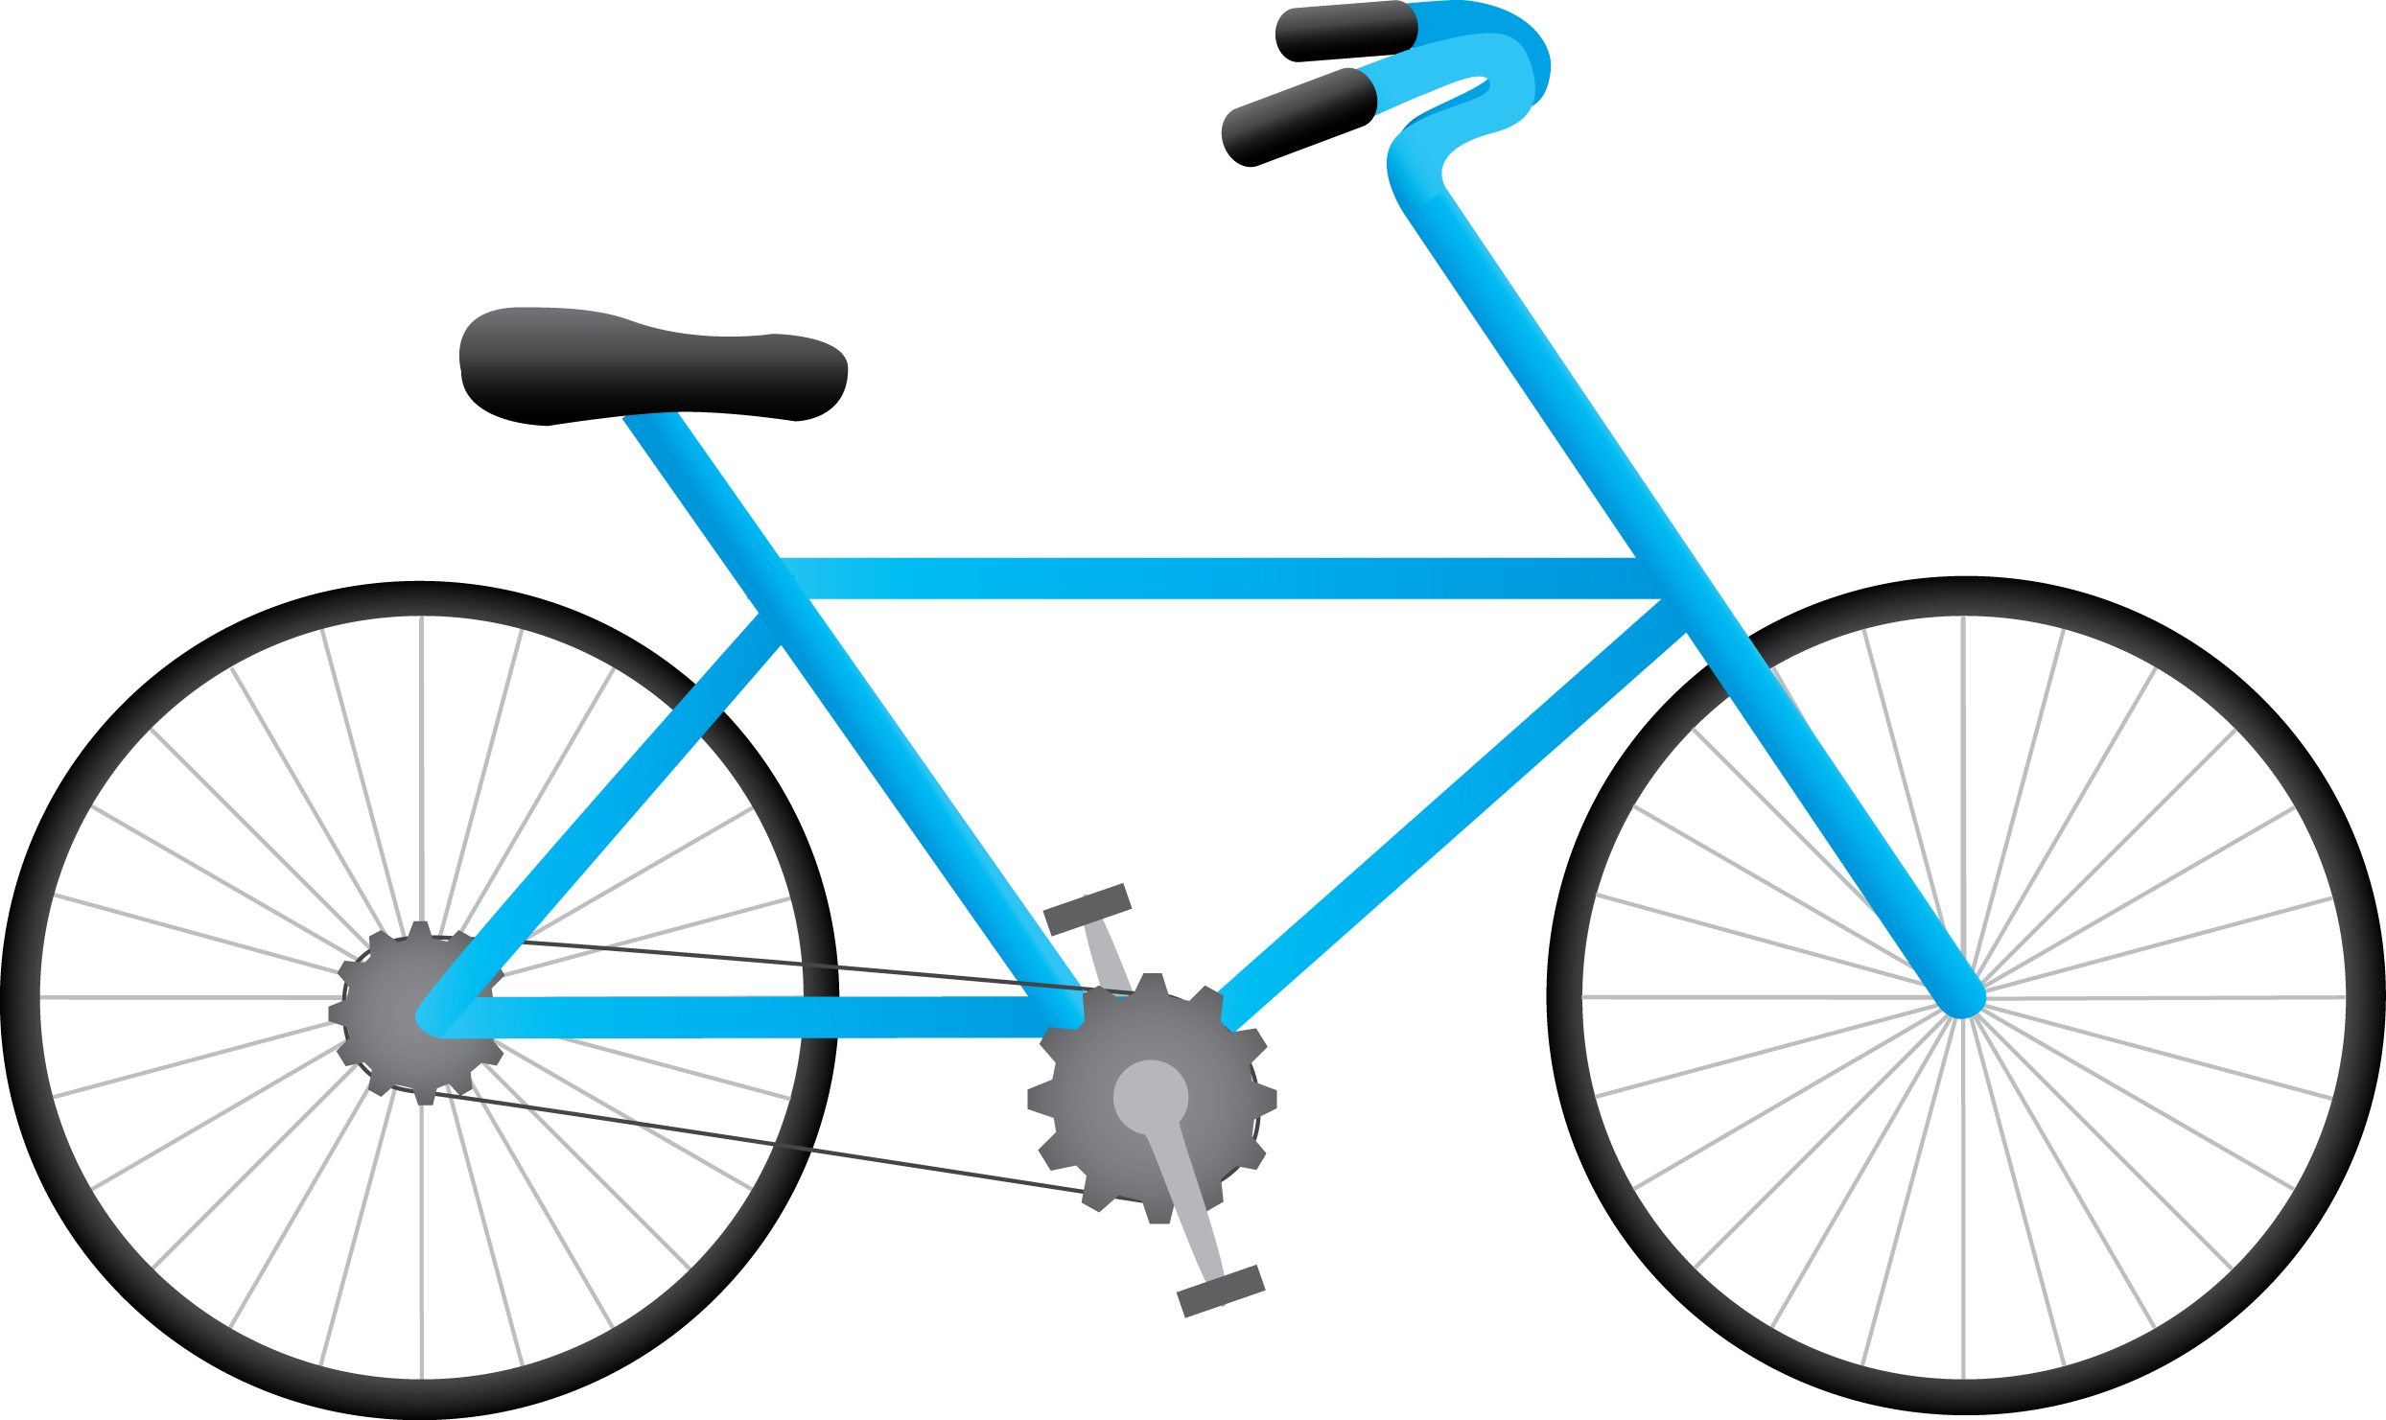
Good enough needs context
This Photo by Unknown Author is licensed under CC BY-NC
This Photo by Unknown Author is licensed under CC BY-SA-NC

Slide 4

One upon a time…
Except this really happened…

Slide 5
What is good enough?
This is the big question
And can “correct” and “good enough” live together in peace and harmony?
Sort of…
Good enough should be limited to how well you meet the correctness goal

Slide 6
Until next time…
Remember that correctness in meeting a specification is the one true goal.
Correct enough isn’t really a possibility
Good enough must still meet the correctness goal, or it isn’t

Slide 7
Questions?
If you have questions, you can:
Comment on YouTube
Email drsql@hotmail.com
Message me on Twitter at drsql
Contact me anywhere on https://linktr.ee/drsql
I may add an episode to discuss or reply directly

Slide 8
Good Enough Clarification
Software must meet requirements
Arguments usually are about:
Look and feel
Trying to do more than the requirements state
Requirements that aren’t specific enough.

